Slide 1
Basic steps to create Slide Show
Import PrintCurrentSlide.bas and PrintFile.bas VBA modules (how to)
Add driver pictures and names to home screen slide
Add driver profile slides
Add store map main screen slide
Add store maps slides with PrintMe Macro (PrintCurrentSlide.bas)
Add driver forms main screen slide
Add driver form slides with PrintFile Macro (create you own VBA module using the PrintFile method with the file’s path) (how to)
Link driver profiles to pictures on home screen
Link store maps to store numbers on store map main screen slide
Link driver form slides to driver form names on driver forms main screen

Slide 2
In Depth Instructions

Slide 3
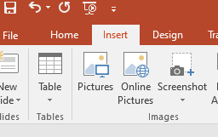
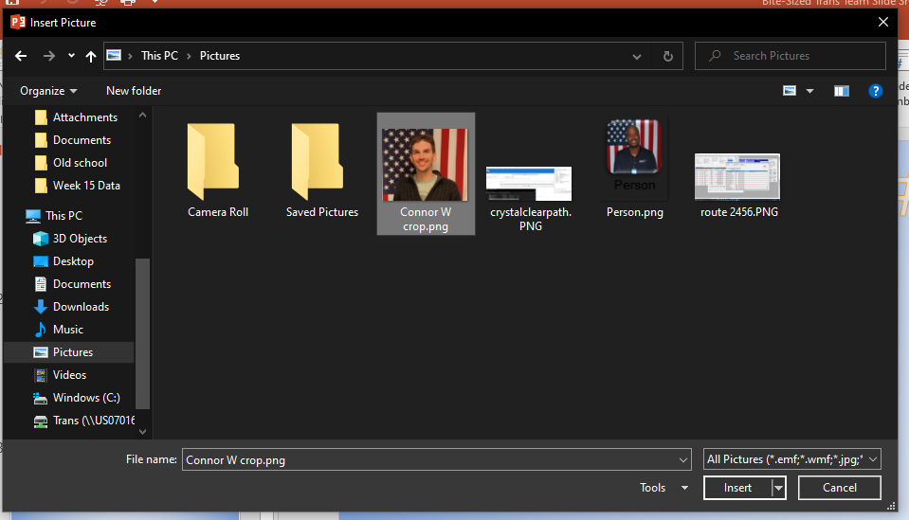
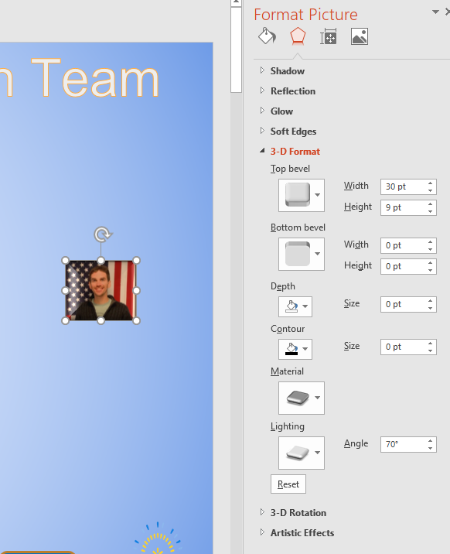
Adding a picture
Go to “Insert” tab and click on “Pictures”
Select the picture to add and click “Insert”
Re-size and format as necessary

Slide 4
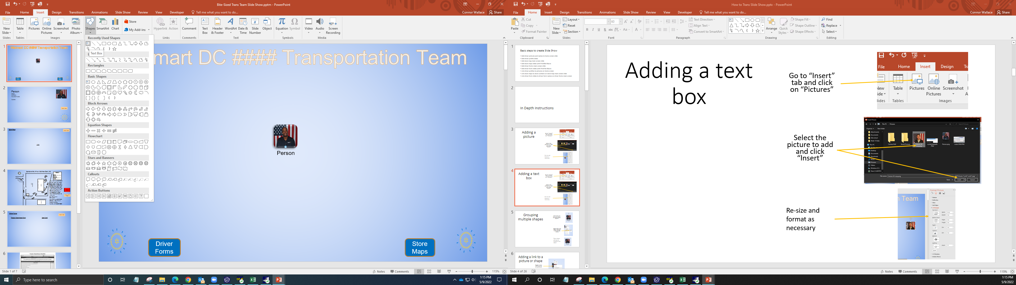
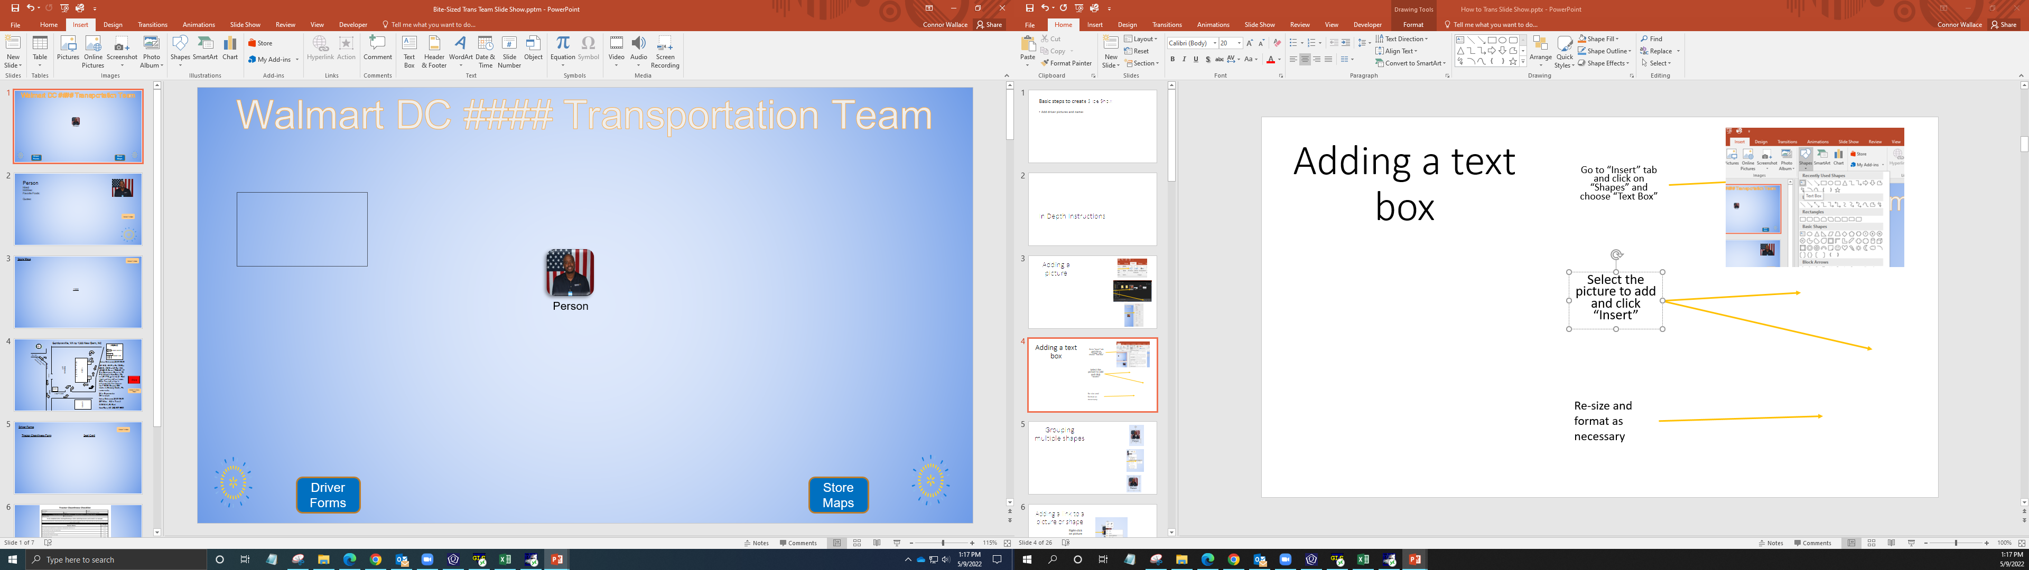
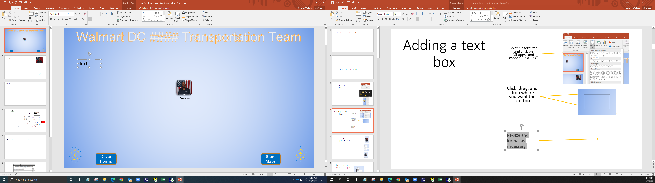
Adding a text box
Go to “Insert” tab and click on “Shapes” and choose “Text Box”
Click, drag, and drop where you want the text box
Enter text

Slide 5
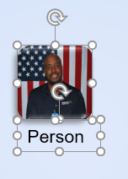
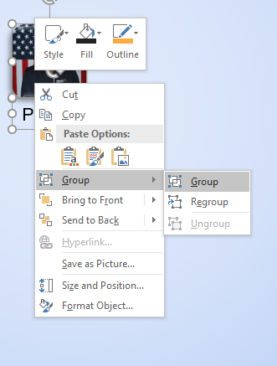

Grouping multiple shapes
Hold ctrl key and click on the shapes you want to group together
Right-click and select “Group” in the Group menu
These shapes will now be treated as one object

Slide 6
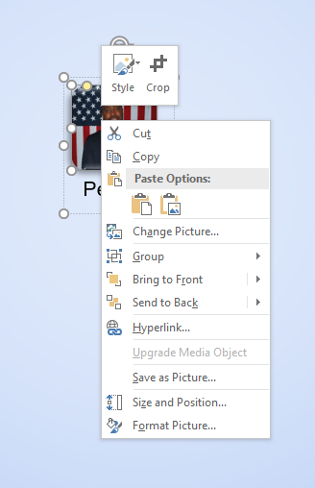
Adding a link to a picture or shape
Right-click on picture
Click on “Hyperlink”

Slide 7
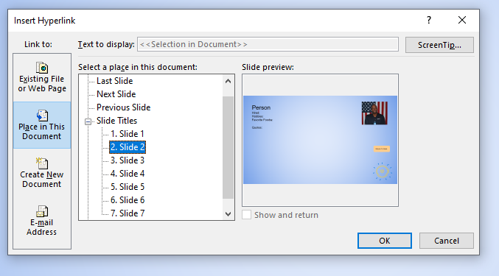
Adding a link to a picture or shape
Click on “Place in this Document”
Click on the location you want the picture to link to

Slide 8
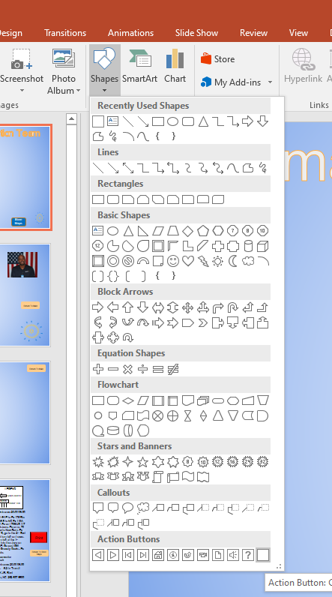
Adding a button
Click on “Shapes” in the “Insert” tab
Click on an “Action button” (we used Action Button: Custom)

Slide 9
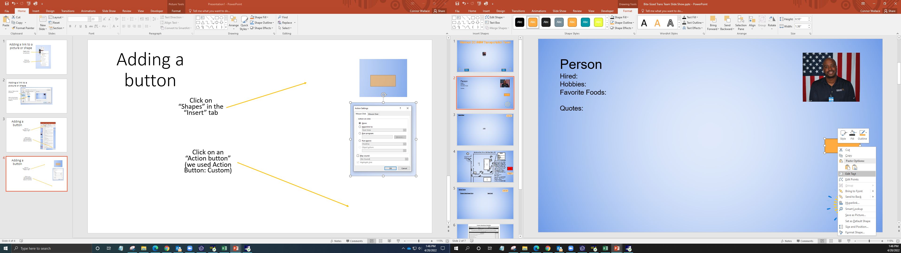
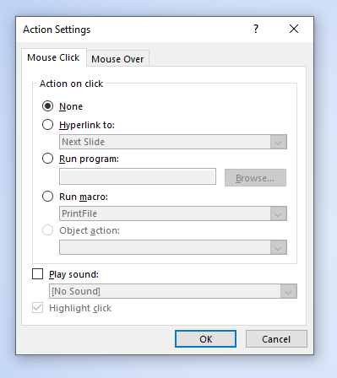
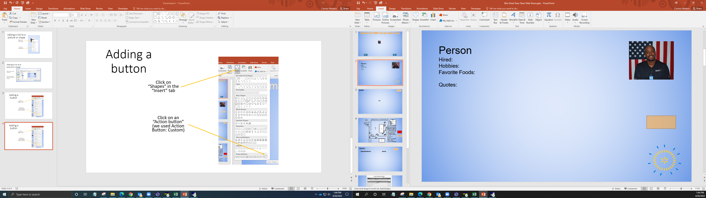
Adding a button
Drag and drop the shape
PowerPoint will prompt you to add an action to your button. Hyperlink to slide, or run macro are the actions we use
You can right click on the button to add text, change colors, etc.

Slide 10
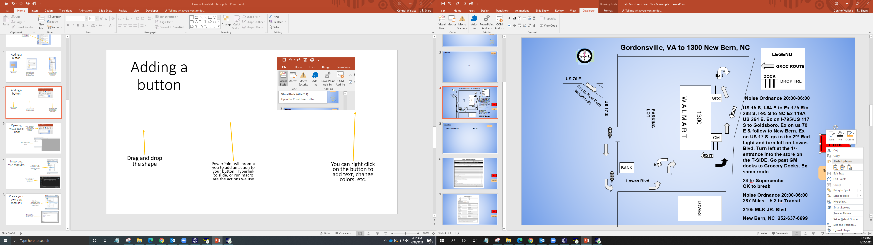
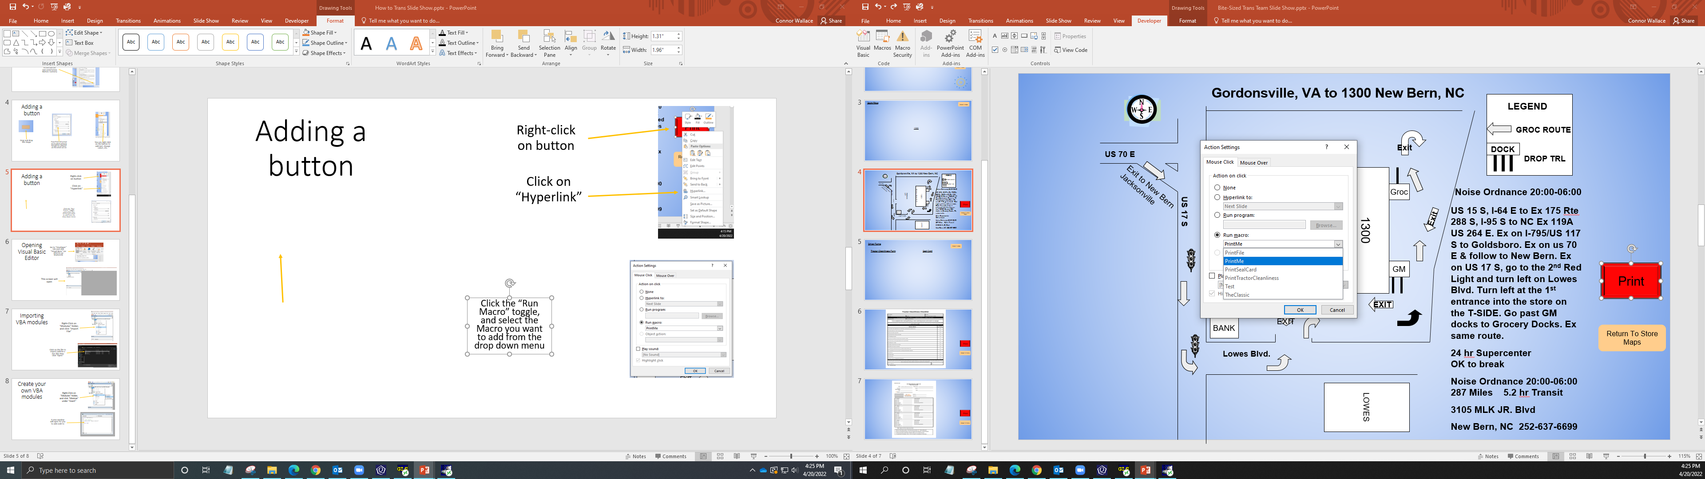
Adding a Macro to a button
Right-click on button
Click on “Hyperlink”
Click the “Run Macro” toggle, and select the Macro you want to add from the drop down menu

Slide 11
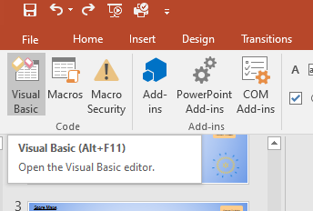
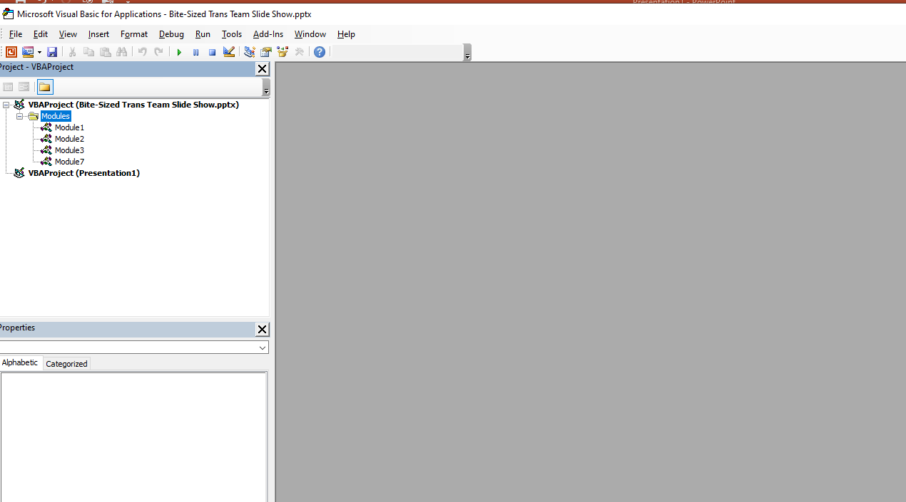
Opening Visual Basic Editor
Go to “Developer” tab and click “Visual Basic” (or Alt+F11 on keyboard)
This screen will open

Slide 12
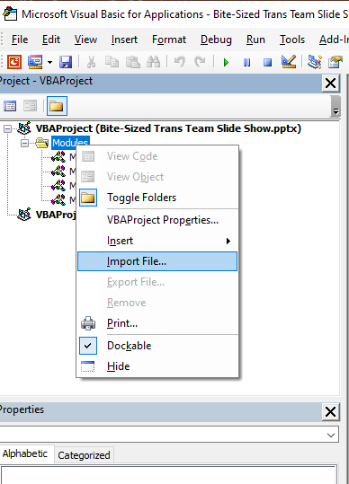
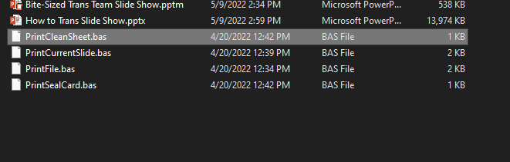
Importing VBA modules
Right-Click on “Modules” folder, and click “Import File”
Click on the file to import (will be a .bas file) then click “Open”

Slide 13
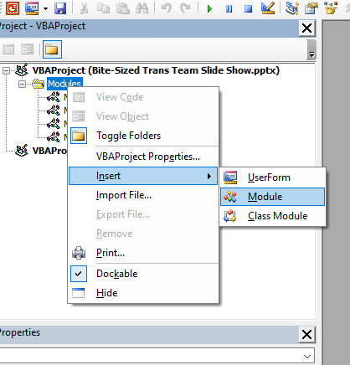
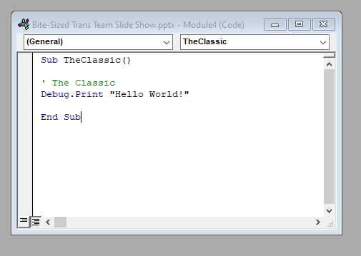
Create your own VBA modules
Right-Click on “Modules” folder, and click “Module” under “Insert”
A new window will open for you to add code to

Slide 14
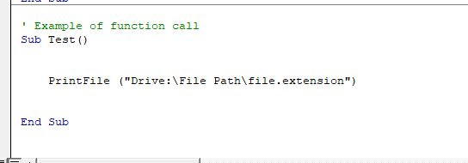
Using “PrintFile” function for specific files
The VBA for the PrintFile function will be included in the example SlideShow
Use the print file function to print files from the computer. This will be necessary for files the drivers need to write on (eg a seal card)

Slide 15
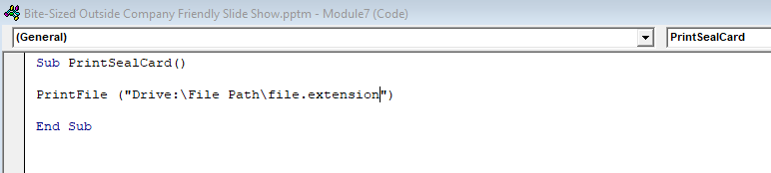
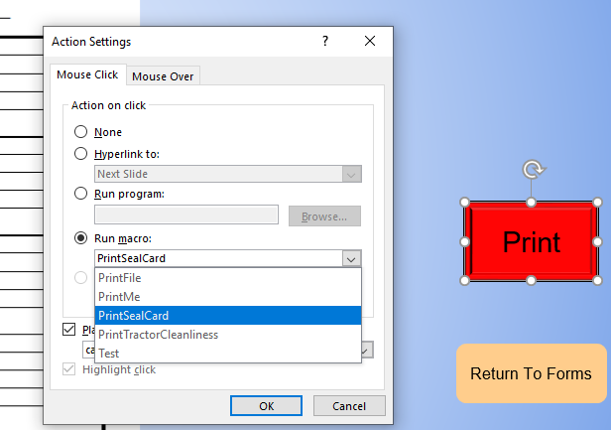
Using “PrintFile” function for specific files
Create a new module
Write a new sub calling “PrintFile” with the path to the document you want to print
How to find a file’s path
Attach this sub to a button in you slideshow

Slide 16
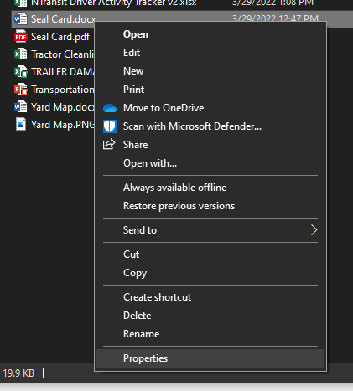
Finding/using a file’s path
Right click on the document and go to “Properties”

Slide 17
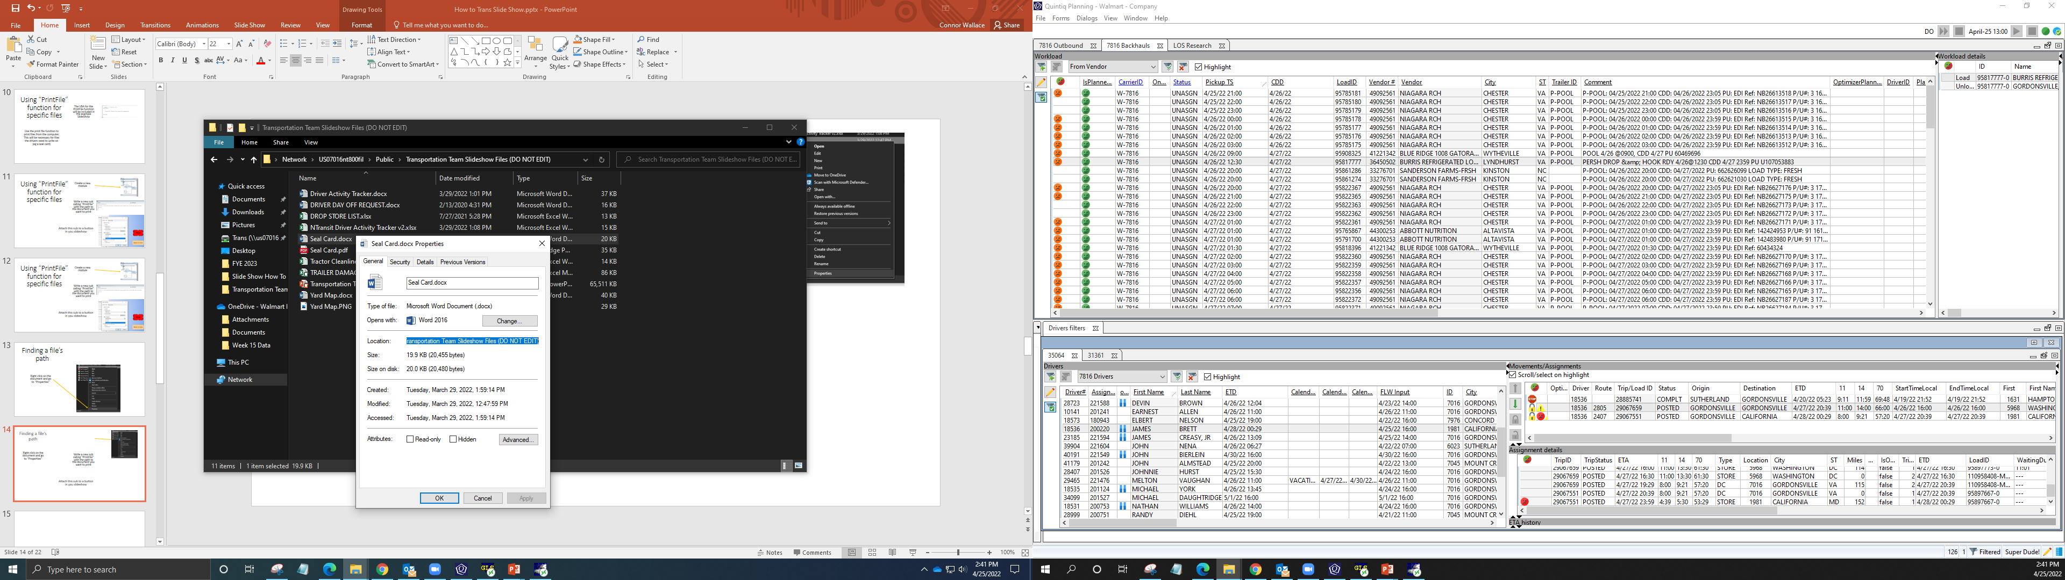
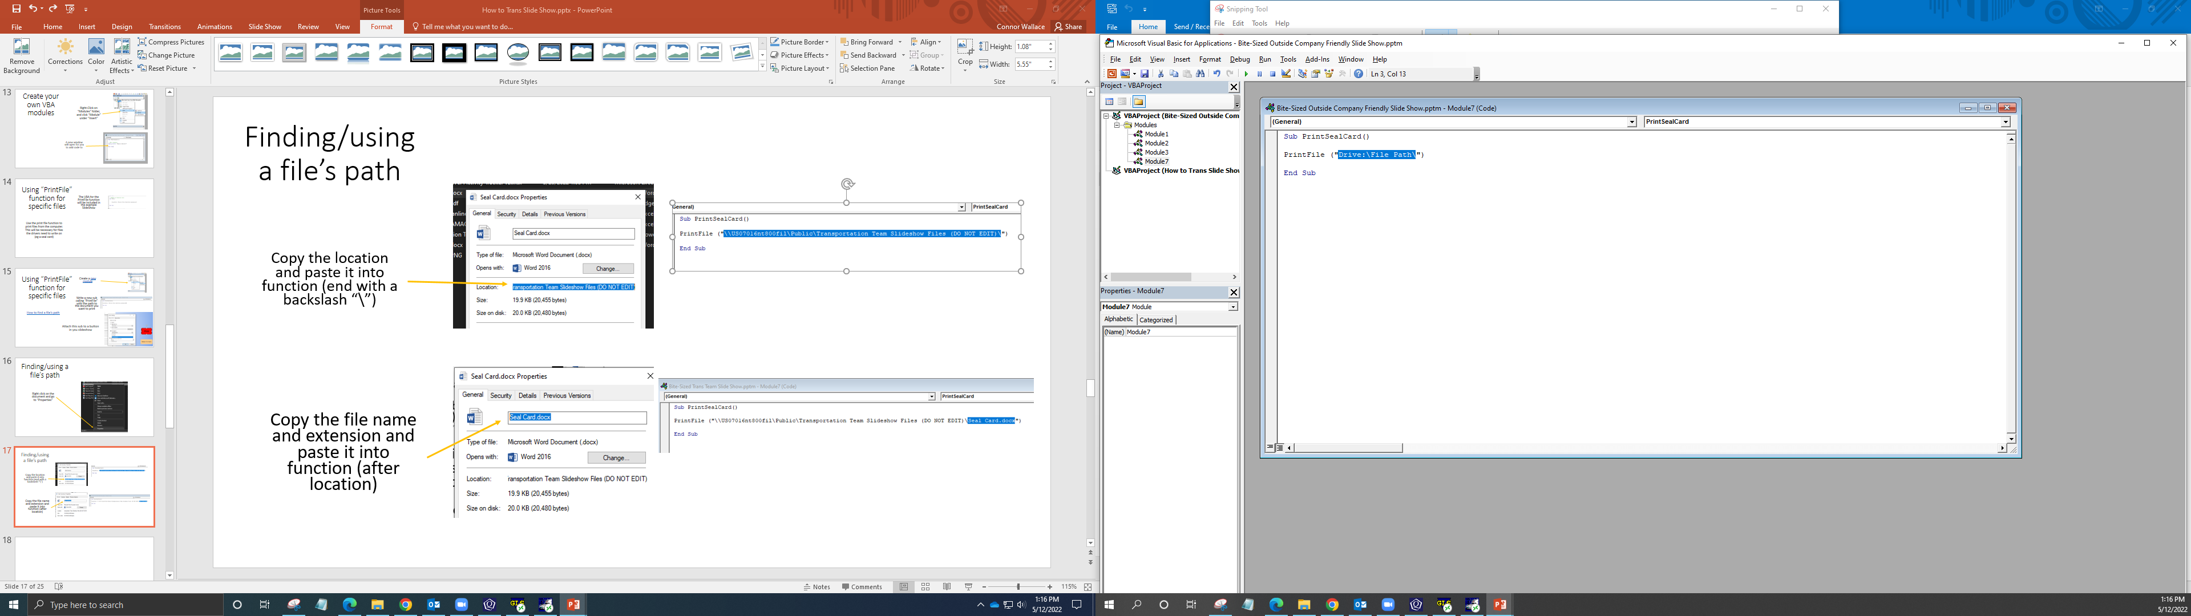
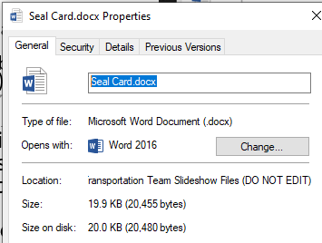
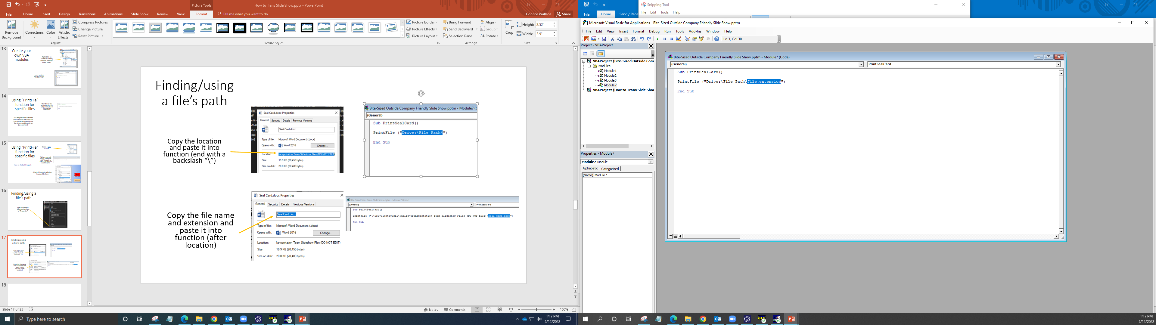
Finding/using a file’s path
Copy the location and paste it into function (end with a backslash “\”)
Copy the file name and extension and paste it into function (after location)

Slide 18
Slide Show Blueprint
What each button does

Slide 19

Company DC #### Transportation Team
Links to Person’s Profile slide
Person
Person
Person
Person
Person
Person
Person
Person
Person
Person
Person
Person
Person
Person
Links to Driver Forms slide
Links to Store Maps slide
Person
Person
Person
Person
Person
Person
Person
Driver Forms
Store Maps

Slide 20

Person Hired: Hobbies: Favorite Foods: Quotes:
Links to Main page
Return To Main

Slide 21
Store Maps
Links to Main page
Return To Main
Links to 1300’s store map slide
Store ####

Slide 22
Origin to Store # and location
LEGEND
GROC ROUTE
Exit
Street #
DOCK
DROP TRL
Store #
Company
Exit to “Exit description”
Groc
Noise Ordnance 20:00-06:00
In-depth, step by step directions
24 hr Store
OK to break
Noise Ordnance 20:00-06:00 ### Miles #.# hr Transit
Complete address for GPS purposes
Prints current slide
Street #
Exit
PARKING LOT
GM
Print
EXIT
EXIT
BANK
Return To Store Maps
Street #
Adjacent Business
Links to Store Maps slide

Slide 23
Driver Forms
Return To Main
Tractor Cleanliness Form
Seal Card
Links to Main page
Links to Tractor Cleanliness slide
Links to Seal Card slide

Slide 24

Prints Tractor Cleanliness file
Print
Return To Forms
Links to Forms slide

Slide 25
Prints Seal Card file
Print
Return To Forms
Links to Forms slide

